Slide 1
the criterion for a two-photon entanglement state in real space
Jieyu You

Slide 2
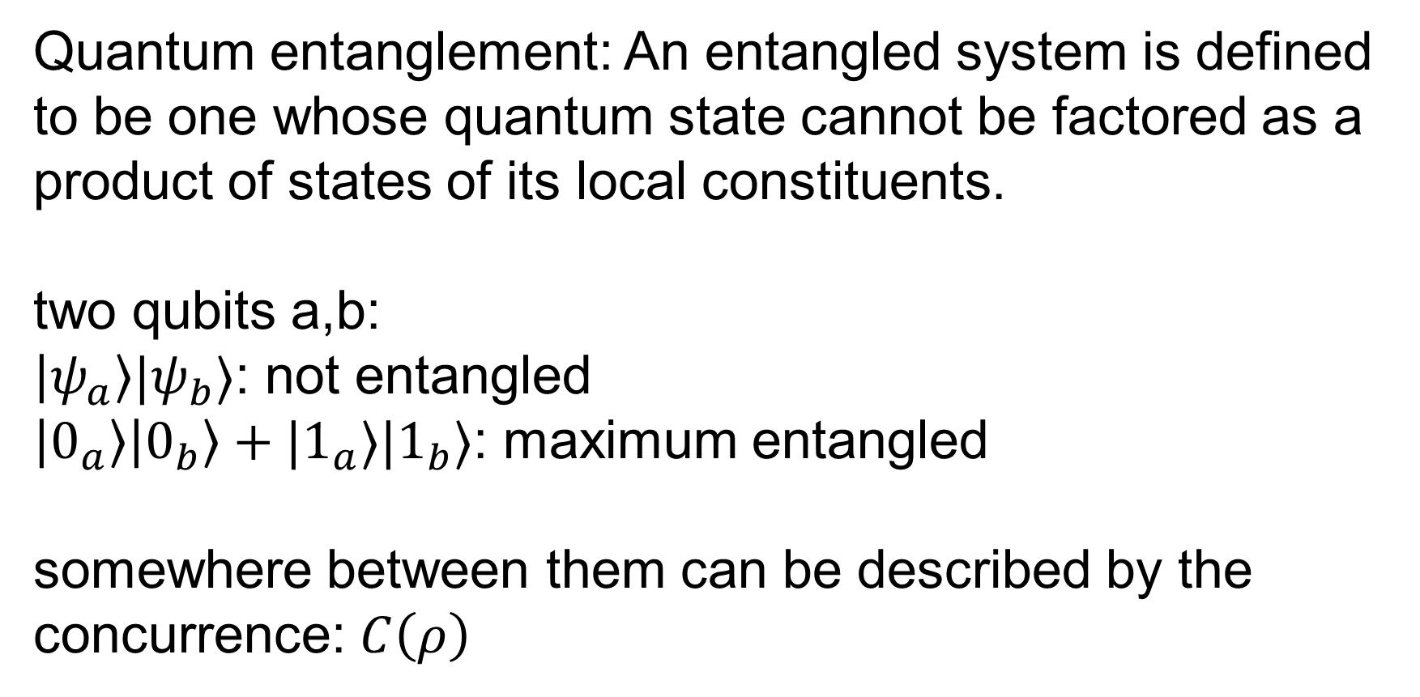
Quantum entanglement: An entangled system is defined to be one whose quantum state cannot be factored as a product of states of its local constituents.
two qubits a,b:
$\left|ψ_{a}\right\rangle |ψ_{b}⟩$: not entangled
$\left|0_{a}\right\rangle \left|0_{b}\right\rangle +|1_{a}⟩|1_{b}⟩$: maximum entangled
somewhere between them can be described by the concurrence: $C\left(ρ\right)$

Slide 3
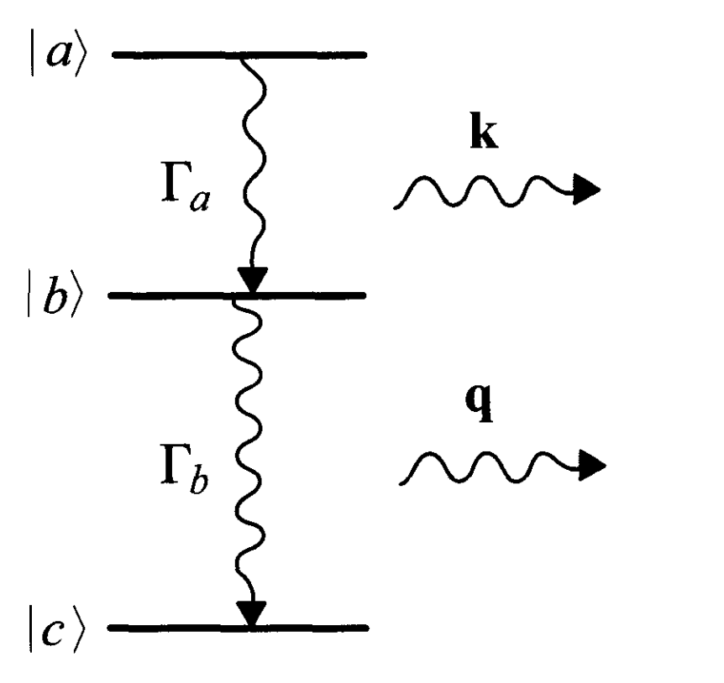
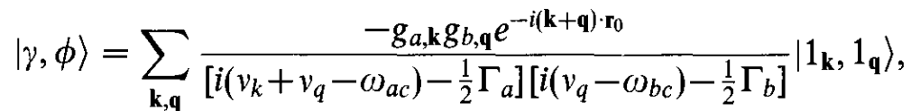
What about two photons?
difficulty: infinite number of modes!
eg: wave packet from two-photon cascade:
idea: convert it into the real space

Slide 4

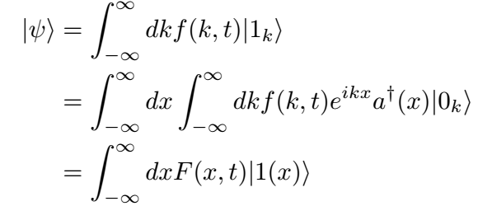
The wavefunction for a photon:
Fourier transform

Slide 5
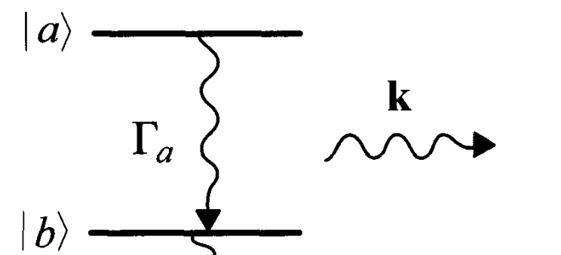
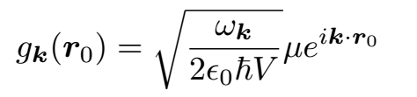


wavepacket from spontaneous decay (1D)
0 for steady state

Slide 6
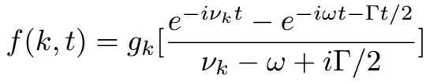
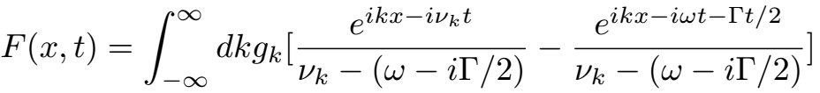
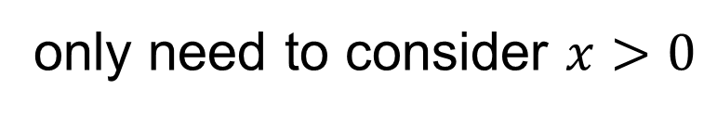


Wigner-Weisskopf approximation:
const
decay
steady state
$$+x$$
$$F\left(x,t\right)=F(−x,t)$$
atom
field point
only need to consider $x>0$

Slide 7
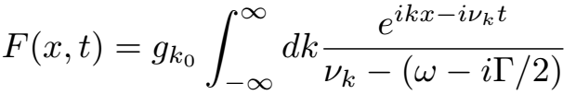

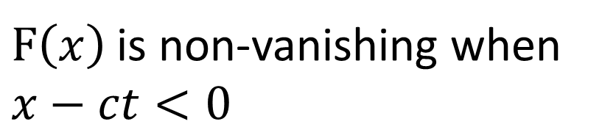
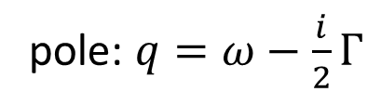
Fourier transform of the first term:
outgoing wave
incoming wave
pole: $q=ω−\frac{i}{2}Γ$
$F\left(x\right)$ is non-vanishing when $x−ct<0$

Slide 8
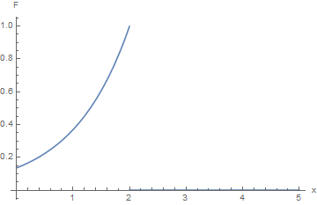
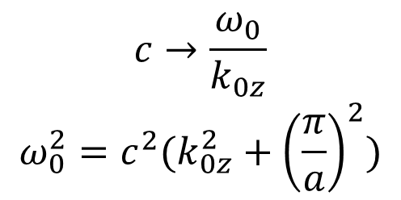

$$c→\frac{ω_{0}}{k_{0z}}$$
$$ω_{0}^{2}=c^{2}(k_{0z}^{2}+{\left(\frac{π}{a}\right)}^{2})$$
$$x=ct$$

Slide 9
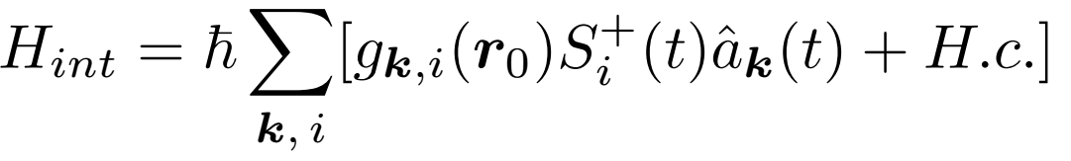
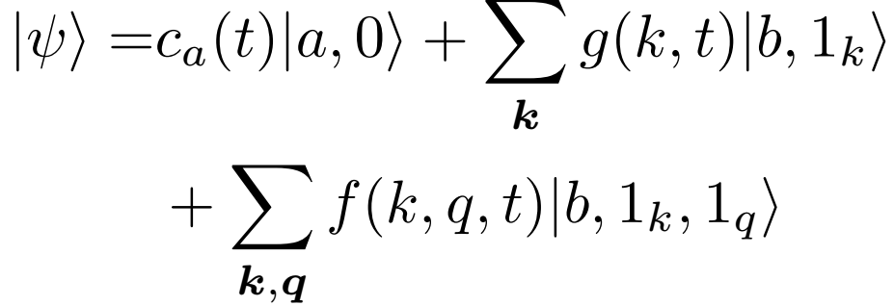
back to the two-photon cascade:

Slide 10
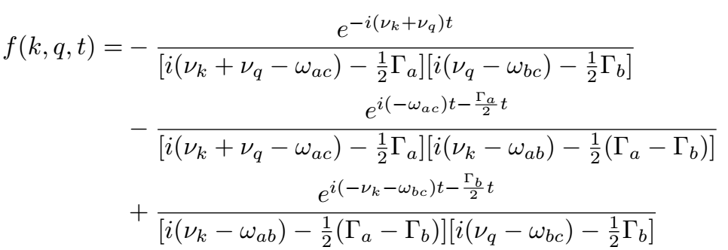
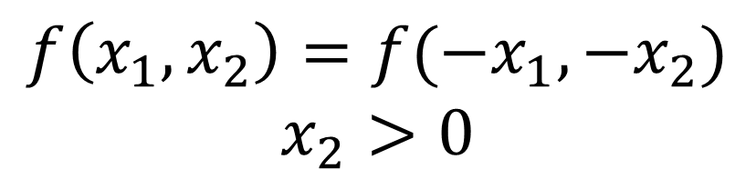
steady state
decay from |a>
decay from |b>
$$f\left(x_{1},x_{2}\right)=f(−x_{1},−x_{2})$$
$$x_{2}>0$$

Slide 11
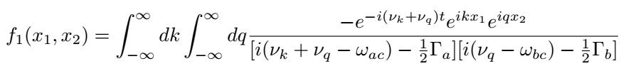
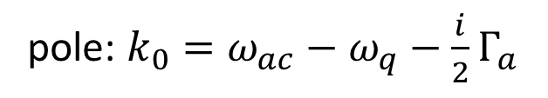
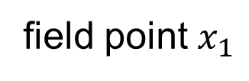
Fourier transform of the first term:
integrate k first due to causality
$$+x$$
pole: $k_{0}=ω_{ac}−ω_{q}−\frac{i}{2}Γ_{a}$
atom
field point $x_{1}$
drop incoming wave (k<0)

Slide 12
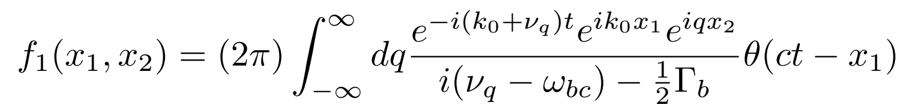
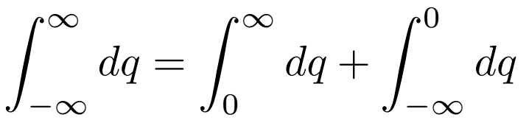




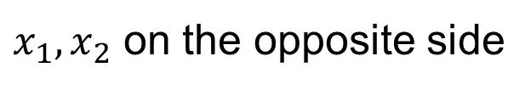

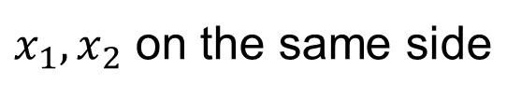

$x_{1},x_{2}$ on the same side
$x_{1},x_{2}$ on the opposite side
$$+x$$
$$+x$$
$$x_{2}$$
atom
$$x_{1}$$
atom
$$x_{1}$$
$$x_{2}$$

Slide 13
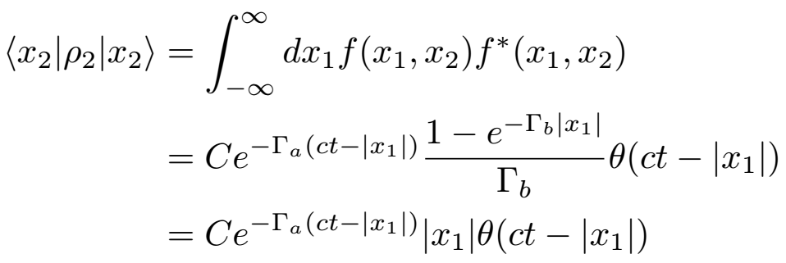
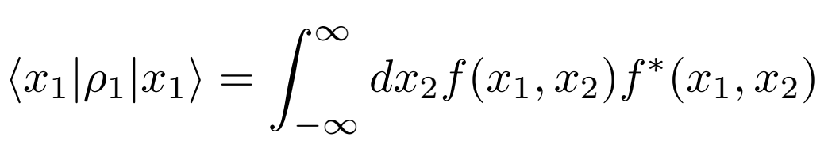
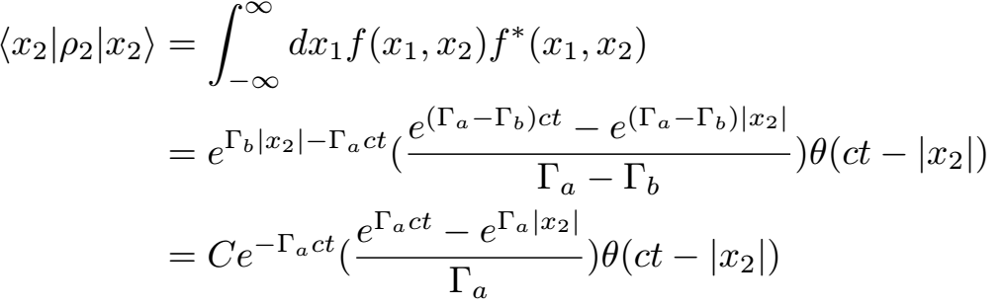
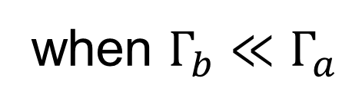
causality
when $Γ_{b}≪Γ_{a}$

Slide 14
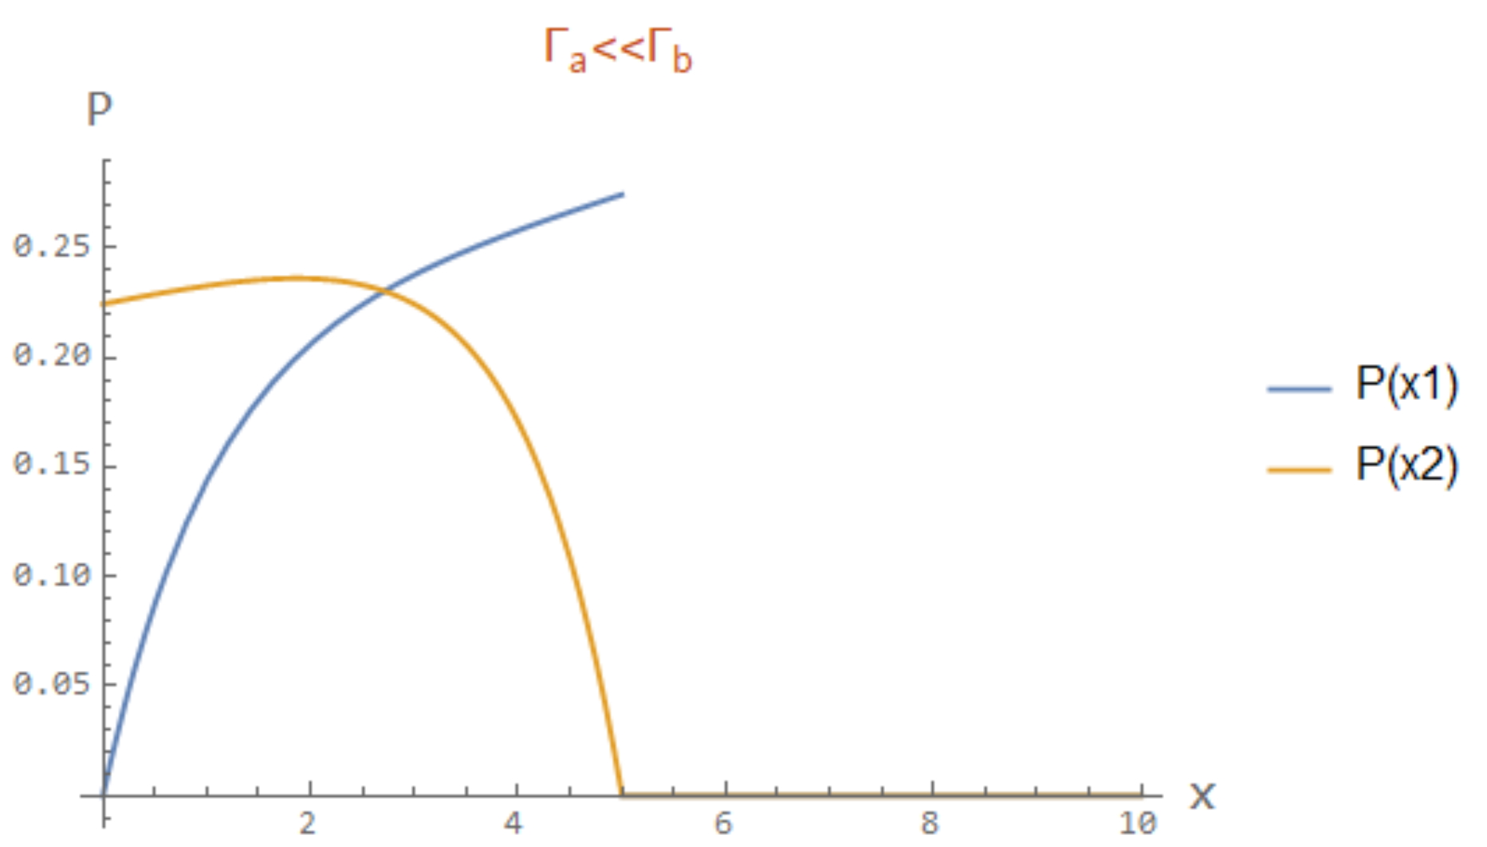
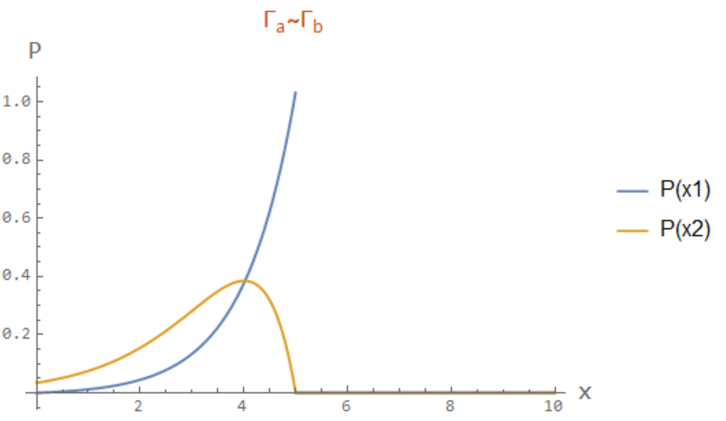
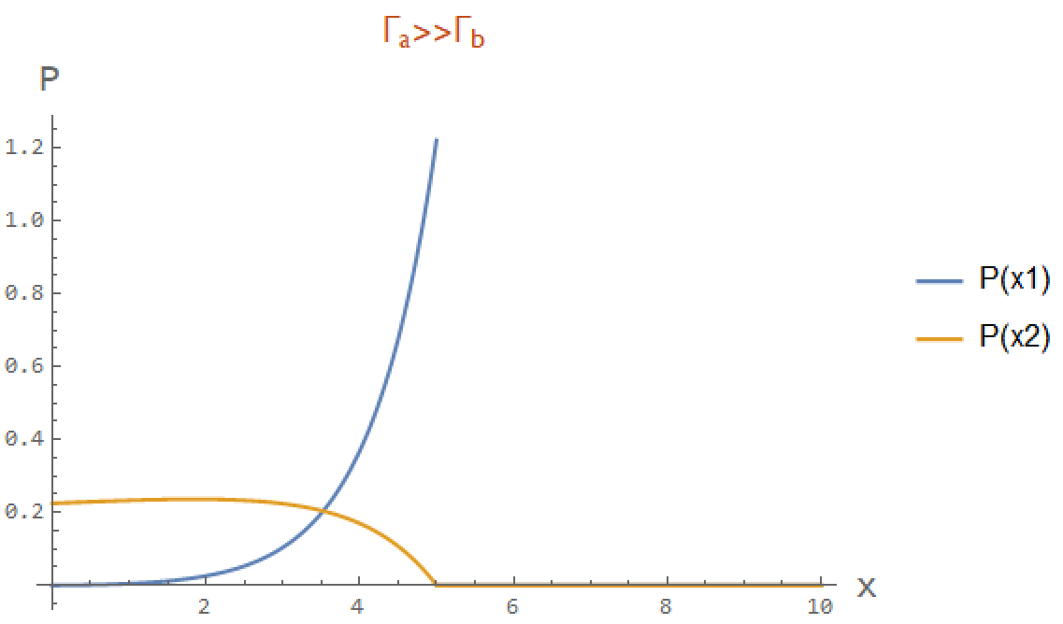

$$x=ct$$

Slide 15
